Slide 1
Neighbors
Gospel of Luke – part 6

Slide 2
Luke 10
²⁵ One day an expert in religious law stood up to test Jesus by asking him this question: “Teacher, what should I do to inherit eternal life?”

Slide 3
Luke 10
²⁶ Jesus replied, “What does the law of Moses say? How do you read it?”
²⁷ The man answered, “‘You must love the Lord your God with all your heart, all your soul, all your strength, and all your mind.’ And, ‘Love your neighbor as yourself.’”
²⁸ “Right!” Jesus told him. “Do this and you will live!”
²⁹ The man wanted to justify his actions, so he asked Jesus, “And who is my neighbor?”

Slide 4
Luke 10
³⁰ Jesus replied with a story: “A Jewish man was traveling from Jerusalem down to Jericho, and he was attacked by bandits. They stripped him of his clothes, beat him up, and left him half dead beside the road.
³¹ “By chance a priest came along. But when he saw the man lying there, he crossed to the other side of the road and passed him by. ³² A Temple assistant walked over and looked at him lying there, but he also passed by on the other side.

Slide 5
Luke 10
³³ “Then a despised Samaritan came along, and when he saw the man, he felt compassion for him. ³⁴ Going over to him, the Samaritan soothed his wounds with olive oil and wine and bandaged them. Then he put the man on his own donkey and took him to an inn, where he took care of him. ³⁵ The next day he handed the innkeeper two silver coins, telling him, ‘Take care of this man. If his bill runs higher than this, I’ll pay you the next time I’m here.’

Slide 6
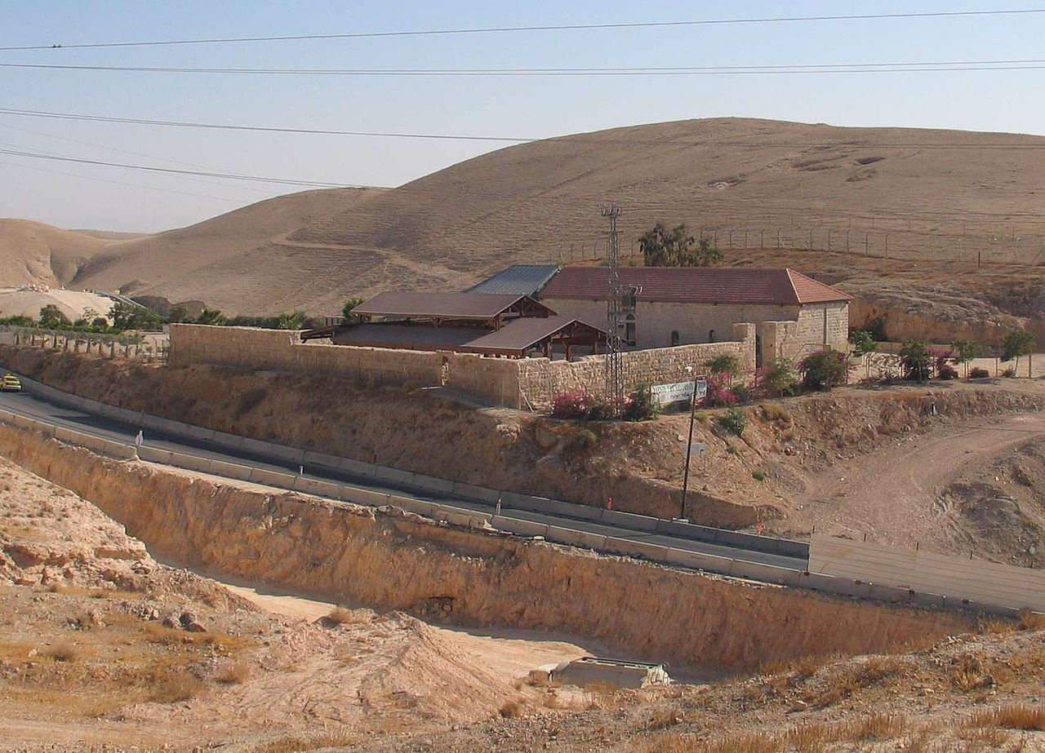

Slide 7
Luke 10
³⁶ “Now which of these three would you say was a neighbor to the man who was attacked by bandits?” Jesus asked.
³⁷ The man replied, “The one who showed him mercy.”
Then Jesus said, “Yes, now go and do the same.”

Slide 8
Those people

Slide 9
Luke 10
³⁸ As Jesus and his disciples were on their way, he came to a village where a woman named Martha opened her home to him. ³⁹ She had a sister called Mary, who sat at the Lord’s feet listening to what he said.

Slide 10
Luke 10
⁴⁰ But Martha was distracted by all the preparations that had to be made. She came to him and asked, “Lord, don’t you care that my sister has left me to do the work by myself? Tell her to help me!”

Slide 11
Luke 10
⁴¹ But the Lord said to her, “My dear Martha, you are worried and upset over all these details! ⁴² There is only one thing worth being concerned about. Mary has discovered it, and it will not be taken away from her.”

Slide 12
Luke 10
²⁷ The man answered, “‘You must love the Lord your God with all your heart, all your soul, all your strength, and all your mind.’ And, ‘Love your neighbor as yourself.’”

Slide 13
Luke 11
Now Jesus was praying in a certain place, and when he finished, one of his disciples said to him, “Lord, teach us to pray, as John taught his disciples.”

Slide 14
Luke 11
² And he said to them, “When you pray, say:
“Father, hallowed be your name. Your kingdom come. ³ Give us each day our daily bread, ⁴ and forgive us our sins, for we ourselves forgive everyone who is indebted to us. And lead us not into temptation.”

Slide 15
Luke 10
²⁷ The man answered, “‘You must love the Lord your God with all your heart, all your soul, all your strength, and all your mind.’ And, ‘Love your neighbor as yourself.’”
²⁸ “Right!” Jesus told him. “Do this and you will live!”

