Slide 1
I Know You
Revelation – part 2

Slide 2
Revelation 1
¹² Then I turned to see the voice that was speaking to me, and on turning I saw seven golden lampstands, ¹³ and in the midst of the lampstands one like a son of man, clothed with a long robe and with a golden sash around his chest. ¹⁴ The hairs of his head were white, like white wool, like snow. His eyes were like a flame of fire, ¹⁵ his feet were like burnished bronze, refined in a furnace, and his voice was like the roar of many waters. ¹⁶ In his right hand he held seven stars, from his mouth came a sharp two-edged sword, and his face was like the sun shining in full strength.

Slide 3
Revelation 1
⁷ When I saw him, I fell at his feet as though dead. But he laid his right hand on me, saying, “Fear not, I am the first and the last, ¹⁸ and the living one. I died, and behold I am alive forevermore, and I have the keys of Death and Hades. ¹⁹ Write therefore the things that you have seen, those that are and those that are to take place after this. ²⁰ As for the mystery of the seven stars that you saw in my right hand, and the seven golden lampstands, the seven stars are the angels of the seven churches, and the seven lampstands are the seven churches.

Slide 4
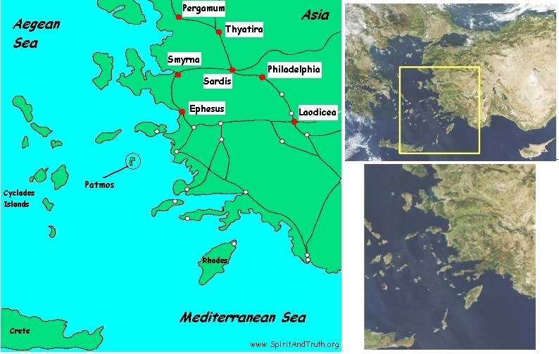

Slide 5
Revelation 2
The words of him who holds the seven stars in his right hand, who walks among the seven golden lampstands…

Slide 6
Revelation 2
“To the angel of the church in Ephesus write:
These are the words of him who holds the seven stars in his right hand and walks among the seven golden lampstands. ² I know your deeds, your hard work and your perseverance. I know that you cannot tolerate wicked people, that you have tested those who claim to be apostles but are not, and have found them false. ³ You have persevered and have endured hardships for my name, and have not grown weary.

Slide 7
Revelation 2
⁴ Yet I hold this against you: You have forsaken the love you had at first. ⁵ Consider how far you have fallen! Repent and do the things you did at first. If you do not repent, I will come to you and remove your lampstand from its place. ⁶ But you have this in your favor: You hate the practices of the Nicolaitans, which I also hate.
⁷ Whoever has ears, let them hear what the Spirit says to the churches. To the one who is victorious, I will give the right to eat from the tree of life, which is in the paradise of God.

Slide 8
Revelation 3
¹⁴ “To the angel of the church in Laodicea write:
These are the words of the Amen, the faithful and true witness, the ruler of God’s creation. ¹⁵ I know your deeds, that you are neither cold nor hot. I wish you were either one or the other! ¹⁶ So, because you are lukewarm—neither hot nor cold—I am about to spit you out of my mouth. ¹⁷ You say, ‘I am rich; I have acquired wealth and do not need a thing.’

Slide 9
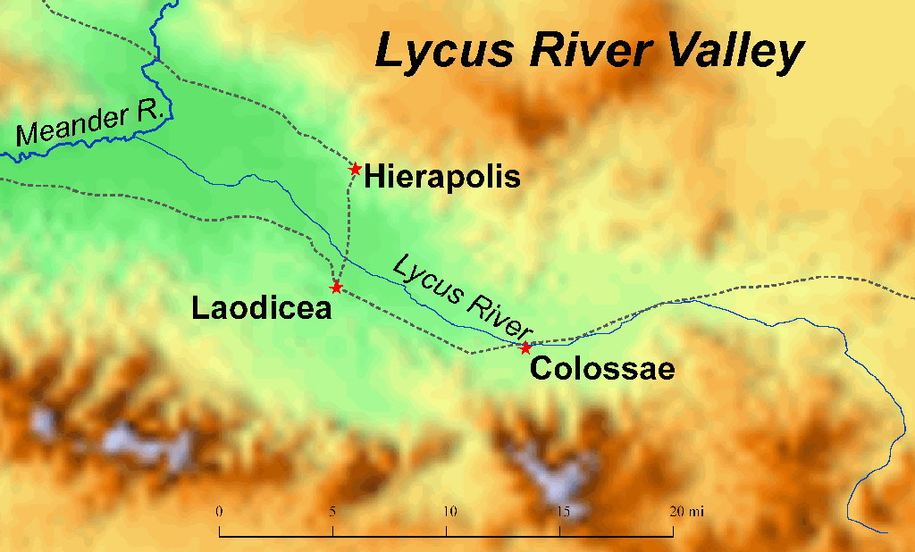

Slide 10
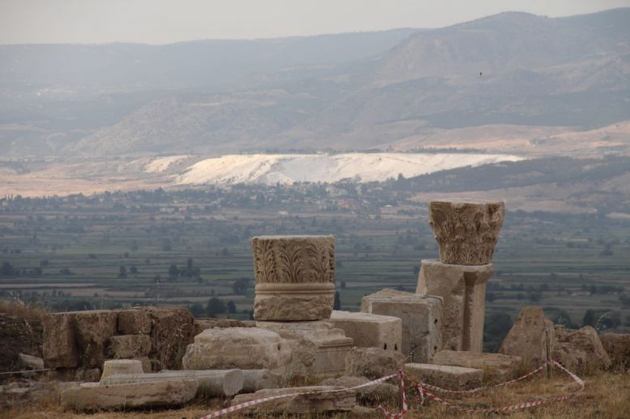

Slide 11
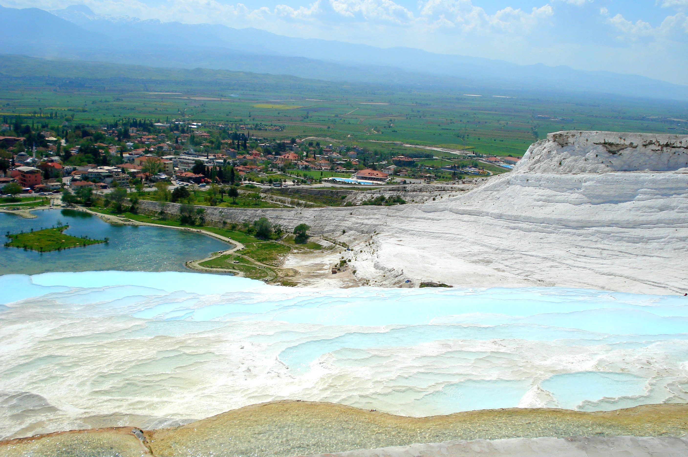

Slide 12
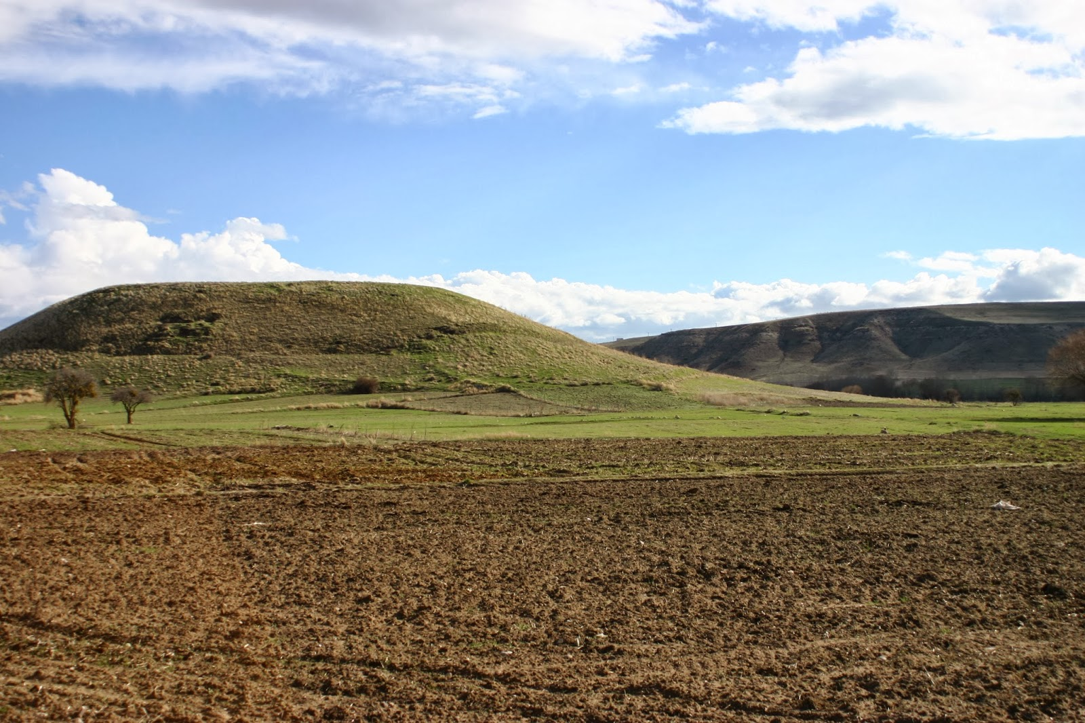

Slide 13
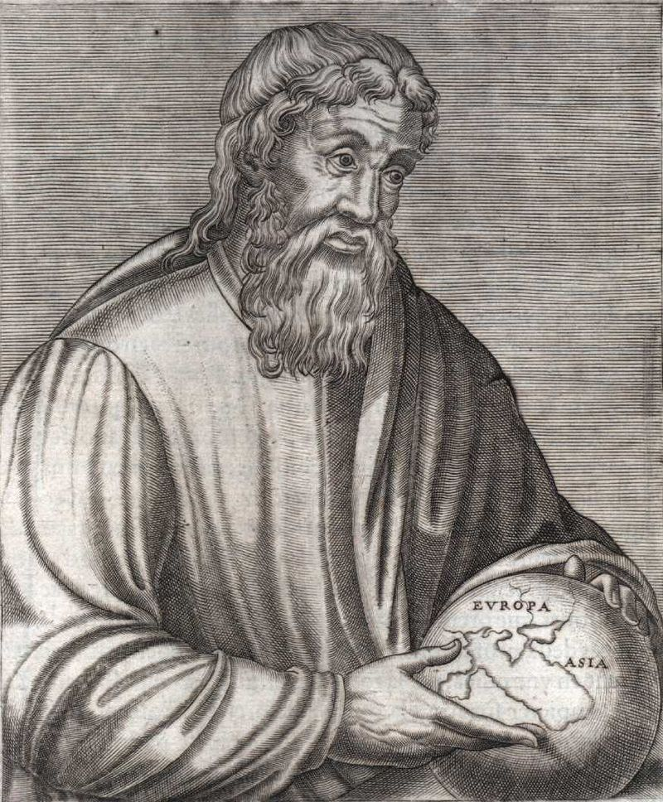
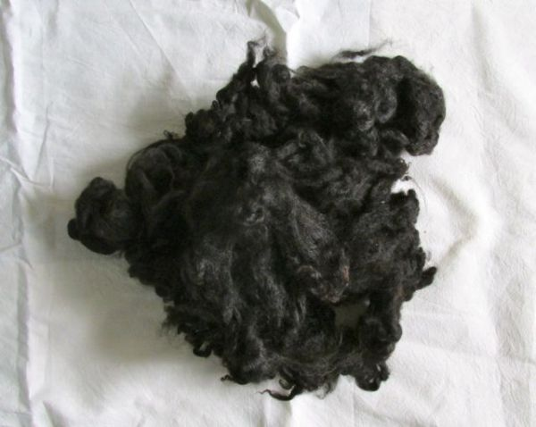

Slide 14
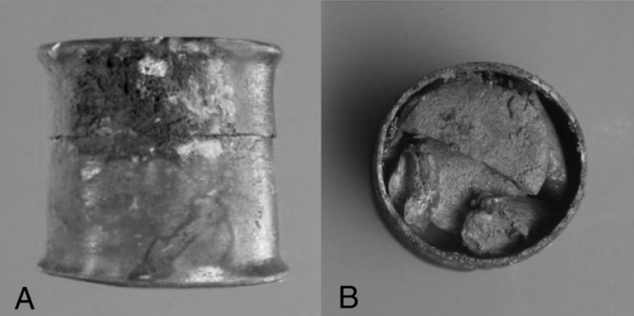

Slide 15
Revelation 3
¹⁷ You say, ‘I am rich; I have acquired wealth and do not need a thing.’ But you do not realize that you are wretched, pitiful, poor, blind and naked.
¹⁸ I counsel you to buy from me gold refined in the fire, so you can become rich; and white clothes to wear, so you can cover your shameful nakedness; and salve to put on your eyes, so you can see.

Slide 16
Revelation 3
¹⁹ I correct and discipline everyone I love. So be diligent and turn from your indifference.

Slide 17
Revelation 2
⁴ Yet I hold this against you: You have forsaken the love you had at first.

Slide 18
Revelation 3
¹⁹ I correct and discipline everyone I love. So be diligent and turn from your indifference.
²⁰ “Look! I stand at the door and knock. If you hear my voice and open the door, I will come in, and we will share a meal together as friends. ²¹ Those who are victorious will sit with me on my throne, just as I was victorious and sat with my Father on his throne.
²² “Anyone with ears to hear must listen to the Spirit and understand what he is saying to the churches.”

Slide 19
John 10
¹⁰ The thief comes only to steal and kill and destroy. I came that they may have life and have it abundantly.

Slide 20
Galatians 5
²² But the fruit of the Spirit is love, joy, peace, patience, kindness, goodness, faithfulness, ²³ gentleness, self-control; against such things there is no law.

