Slide 1
Throne
Revelation – part 3

Slide 2
Revelation 2
The words of him who holds the seven stars in his right hand, who walks among the seven golden lampstands…

Slide 3
Revelation 3
¹⁹ I correct and discipline everyone I love. So be diligent and turn from your indifference.
²⁰ “Look! I stand at the door and knock. If you hear my voice and open the door, I will come in, and we will share a meal together as friends. ²¹ Those who are victorious will sit with me on my throne, just as I was victorious and sat with my Father on his throne.
²² “Anyone with ears to hear must listen to the Spirit and understand what he is saying to the churches.”

Slide 4
Revelation 4
After this I looked, and behold, a door standing open in heaven! And the first voice, which I had heard speaking to me like a trumpet, said, “Come up here, and I will show you what must take place after this.”

Slide 5
Revelation 4
² At once I was in the Spirit, and behold, a throne stood in heaven, with one seated on the throne. ³ And he who sat there had the appearance of jasper and carnelian, and around the throne was a rainbow that had the appearance of an emerald.

Slide 6
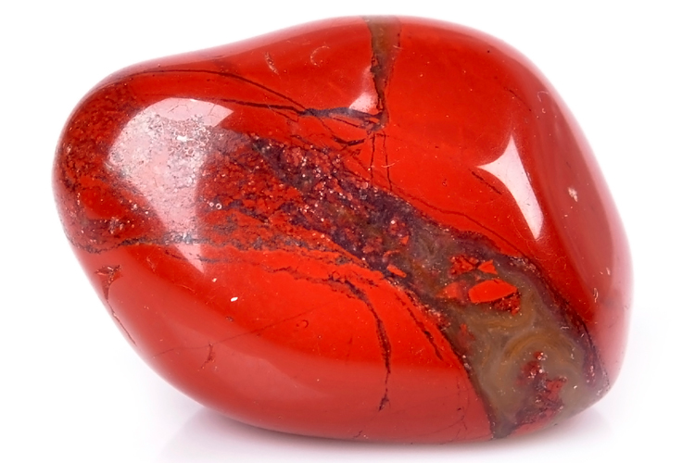
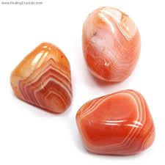

Slide 7
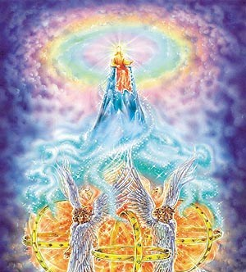

Slide 8
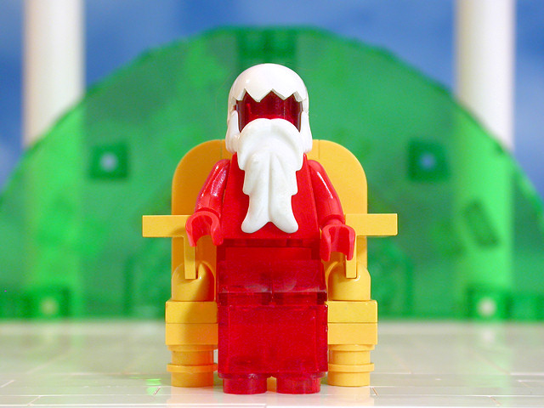

Slide 9
“But do I see you as you really are?” he asked.
“Only [God] sees any creature as it really is.” said Mars.
“How do you see one another?” asked Ransom.
“There are no holding places in your mind for an answer to that.”
“Am I then seeing only an appearance? Is it not real at all?”
“You see only an appearance, small one. You have never seen more than an appearance of anything – not of the sun, nor of a stone, nor of your own body. This appearance is as true as what you see of those.”
-from “Perelandra”
C.S. Lewis

Slide 10
Be comforted small immortals. You are not the voice that all things that all things utter, nor is there eternal silence in the places you cannot come.
-from “Perelandra”
C.S. Lewis

Slide 11
Revelation 4
⁴ Around the throne were twenty-four thrones, and seated on the thrones were twenty-four elders, clothed in white garments, with golden crowns on their heads. ⁵ From the throne came flashes of lightning, and rumblings and peals of thunder, and before the throne were burning seven torches of fire, which are the seven spirits of God, ⁶ and before the throne there was as it were a sea of glass, like crystal.

Slide 12
Revelation 4
And around the throne, on each side of the throne, are four living creatures, full of eyes in front and behind: ⁷ the first living creature like a lion, the second living creature like an ox, the third living creature with the face of a man, and the fourth living creature like an eagle in flight.

Slide 13
Revelation 4
⁸ And the four living creatures, each of them with six wings, are full of eyes all around and within, and day and night they never cease to say,
“Holy, holy, holy, is the Lord God Almighty, who was and is and is to come!”

Slide 14
Revelation 4
⁹ And whenever the living creatures give glory and honor and thanks to him who is seated on the throne, who lives forever and ever, ¹⁰ the twenty-four elders fall down before him who is seated on the throne and worship him who lives forever and ever. They cast their crowns before the throne, saying,
¹¹ “Worthy are you, our Lord and God, to receive glory and honor and power, for you created all things, and by your will they existed and were created.”

Slide 15
Revelation 4
⁹ And whenever the living creatures give glory and honor and thanks to him who is seated on the throne, who lives forever and ever, ¹⁰ the twenty-four elders fall down before him who is seated on the throne and worship him who lives forever and ever. They cast their crowns before the throne, saying,
¹¹ “Worthy are you, our Lord and God, to receive glory and honor and power, for you created all things, and by your will they existed and were created.”

Slide 16
Colossians 1
¹⁵ Christ is the visible image of the invisible God. He existed before anything was created and is supreme over all creation, ¹⁶ for through him God created everything in the heavenly realms and on earth. He made the things we can see and the things we can’t see— such as thrones, kingdoms, rulers, and authorities in the unseen world. Everything was created through him and for him. ¹⁷ He existed before anything else, and he holds all creation together.

Slide 17
Colossians 1
¹⁸ Christ is also the head of the church, which is his body. He is the beginning, supreme over all who rise from the dead. So he is first in everything. ¹⁹ For God in all his fullness was pleased to live in Christ, ²⁰ and through him God reconciled everything to himself. He made peace with everything in heaven and on earth by means of Christ’s blood on the cross.

Slide 18
Colossians 1
²¹ This includes you who were once far away from God. You were his enemies, separated from him by your evil thoughts and actions. ²² Yet now he has reconciled you to himself through the death of Christ in his physical body. As a result, he has brought you into his own presence, and you are holy and blameless as you stand before him without a single fault.
²³ But you must continue to believe this truth and stand firmly in it. Don’t drift away from the assurance you received when you heard the Good News.

