Slide 1
Water, Earth, Wine
Signs – part 1

Slide 2
In the beginning

Slide 3
John 1
In the beginning was the Word, and the Word was with God, and the Word was God.

Slide 4
John 2
On the third day a wedding took place at Cana in Galilee. Jesus’ mother was there, ² and Jesus and his disciples had also been invited to the wedding. ³ When the wine was gone, Jesus’ mother said to him, “They have no more wine.”
⁴ “Woman, why do you involve me?” Jesus replied. “My hour has not yet come.”
⁵ His mother said to the servants, “Do whatever he tells you.”
⁶ Nearby stood six stone water jars, the kind used by the Jews for ceremonial washing, each holding from twenty to thirty gallons.

Slide 5
John 2
⁶ Nearby stood six stone water jars, the kind used by the Jews for ceremonial washing, each holding from twenty to thirty gallons.
⁷ Jesus said to the servants, “Fill the jars with water”; so they filled them to the brim.
⁸ Then he told them, “Now draw some out and take it to the master of the banquet.”
They did so, ⁹ and the master of the banquet tasted the water that had been turned into wine. He did not realize where it had come from, though the servants who had drawn the water knew. Then he called the bridegroom aside ¹⁰ and said, “Everyone brings out the choice wine first and then the cheaper wine after the guests have had too much to drink; but you have saved the best till now.”
¹¹ What Jesus did here in Cana of Galilee was the first of the signs through which he revealed his glory; and his disciples believed in him.

Slide 6
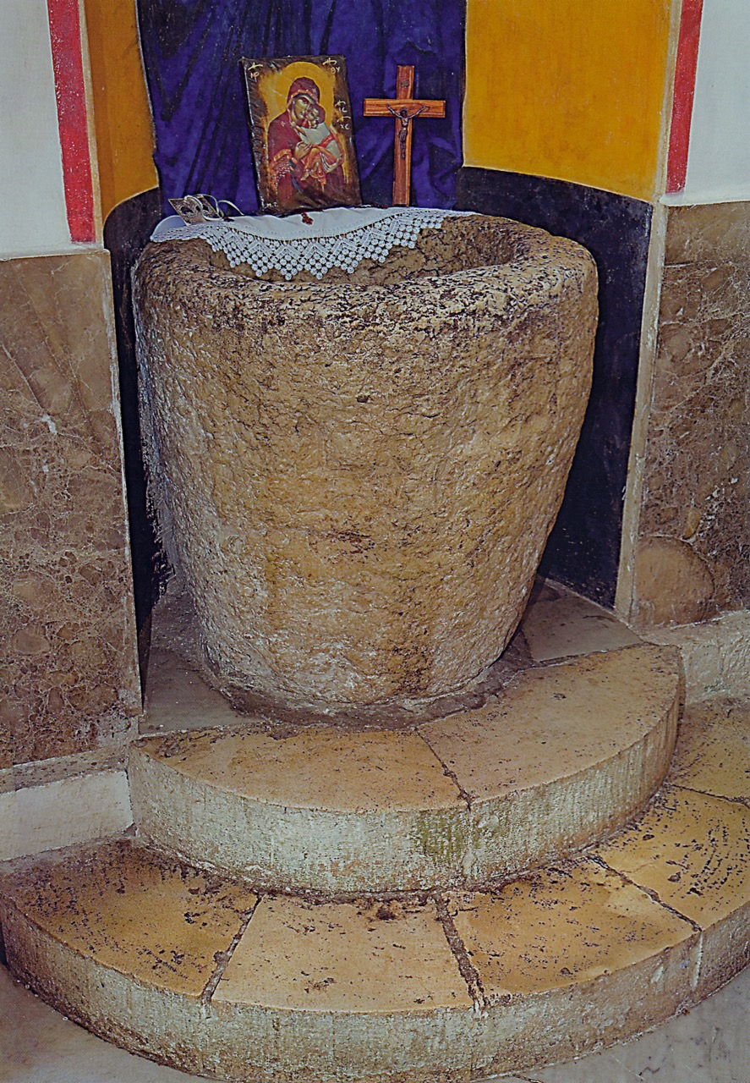

Slide 7
Amos 9
¹³ “The days are coming,” declares the Lord,
“when the reaper will be overtaken by the plowman and the planter by the one treading grapes. New wine will drip from the mountains and flow from all the hills

Slide 8
John 2
On the third day a wedding took place at Cana in Galilee.

Slide 9
Genesis 1
⁹ And God said, “Let the water under the sky be gathered to one place, and let dry ground appear.” And it was so. ¹⁰ God called the dry ground “land,” and the gathered waters he called “seas.” And God saw that it was good.
¹¹ Then God said, “Let the land produce vegetation: seed-bearing plants and trees on the land that bear fruit with seed in it, according to their various kinds.” And it was so. ¹² The land produced vegetation: plants bearing seed according to their kinds and trees bearing fruit with seed in it according to their kinds. And God saw that it was good. ¹³ And there was evening, and there was morning—the third day.

Slide 10
John 2
⁶ Nearby stood six stone water jars, the kind used by the Jews for ceremonial washing, each holding from twenty to thirty gallons.
⁷ Jesus said to the servants, “Fill the jars with water”; so they filled them to the brim.
⁸ Then he told them, “Now draw some out and take it to the master of the banquet.”
They did so, ⁹ and the master of the banquet tasted the water that had been turned into wine. He did not realize where it had come from, though the servants who had drawn the water knew. Then he called the bridegroom aside ¹⁰ and said, “Everyone brings out the choice wine first and then the cheaper wine after the guests have had too much to drink; but you have saved the best till now.”
¹¹ What Jesus did here in Cana of Galilee was the first of the signs through which he revealed his glory; and his disciples believed in him.

Slide 11
Revelation 21
² I saw the Holy City, the new Jerusalem, coming down out of heaven from God, prepared as a bride beautifully dressed for her husband. ³ And I heard a loud voice from the throne saying, “Look! God’s dwelling place is now among the people, and he will dwell with them. They will be his people, and God himself will be with them and be their God. ⁴ ‘He will wipe every tear from their eyes. There will be no more death’ or mourning or crying or pain, for the old order of things has passed away.”
⁵ He who was seated on the throne said, “I am making everything new!” Then he said, “Write this down, for these words are trustworthy and true.”

Slide 12
John 2
On the third day a wedding took place at Cana in Galilee. Jesus’ mother was there, ² and Jesus and his disciples had also been invited to the wedding. ³ When the wine was gone, Jesus’ mother said to him, “They have no more wine.”

Slide 13
John 14
¹² Very truly I tell you, whoever believes in me will do the works I have been doing, and they will do even greater things than these, because I am going to the Father.

