Slide 1
Life
Signs – part 6

Slide 2
John 11
Now a man named Lazarus was sick. He was from Bethany, the village of Mary and her sister Martha. ² (This Mary, whose brother Lazarus now lay sick, was the same one who poured perfume on the Lord and wiped his feet with her hair.) ³ So the sisters sent word to Jesus, “Lord, the one you love is sick.”
⁴ When he heard this, Jesus said, “This sickness will not end in death. No, it is for God’s glory so that God’s Son may be glorified through it.” ⁵ Now Jesus loved Martha and her sister and Lazarus. ⁶ So when he heard that Lazarus was sick, he stayed where he was two more days, ⁷ and then he said to his disciples, “Let us go back to Judea.”
⁸ “But Rabbi,” they said, “a short while ago the Jews there tried to stone you, and yet you are going back?”
⁹ Jesus answered, “Are there not twelve hours of daylight? Anyone who walks in the daytime will not stumble, for they see by this world’s light. ¹⁰ It is when a person walks at night that they stumble, for they have no light.”

Slide 3
John 11
¹¹ After he had said this, he went on to tell them, “Our friend Lazarus has fallen asleep; but I am going there to wake him up.”
¹² His disciples replied, “Lord, if he sleeps, he will get better.” ¹³ Jesus had been speaking of his death, but his disciples thought he meant natural sleep.
¹⁴ So then he told them plainly, “Lazarus is dead, ¹⁵ and for your sake I am glad I was not there, so that you may believe. But let us go to him.”
¹⁶ Then Thomas (also known as Didymus) said to the rest of the disciples, “Let us also go, that we may die with him.”

Slide 4
John 11
¹⁷ On his arrival, Jesus found that Lazarus had already been in the tomb for four days. ¹⁸ Now Bethany was less than two miles from Jerusalem, ¹⁹ and many people had come to Martha and Mary to comfort them in the loss of their brother. ²⁰ When Martha heard that Jesus was coming, she went out to meet him, but Mary stayed at home.
²¹ “Lord,” Martha said to Jesus, “if you had been here, my brother would not have died. ²² But I know that even now God will give you whatever you ask.”
²³ Jesus said to her, “Your brother will rise again.”
²⁴ Martha answered, “I know he will rise again in the resurrection at the last day.”
²⁵ Jesus said to her, “I am the resurrection and the life. The one who believes in me will live, even though they die; ²⁶ and whoever lives by believing in me will never die. Do you believe this?”
²⁷ “Yes, Lord,” she replied, “I believe that you are the Messiah, the Son of God, who is to come into the world.”

Slide 5
John 11
²⁸ After she had said this, she went back and called her sister Mary aside. “The Teacher is here,” she said, “and is asking for you.” ²⁹ When Mary heard this, she got up quickly and went to him. ³⁰ Now Jesus had not yet entered the village, but was still at the place where Martha had met him. ³¹ When the Jews who had been with Mary in the house, comforting her, noticed how quickly she got up and went out, they followed her, supposing she was going to the tomb to mourn there.
³² When Mary reached the place where Jesus was and saw him, she fell at his feet and said, “Lord, if you had been here, my brother would not have died.”

Slide 6
John 11
³ When Jesus saw her weeping, and the Jews who had come along with her also weeping, he was deeply moved in spirit and troubled. ³⁴ “Where have you laid him?” he asked.
“Come and see, Lord,” they replied.
³⁵ Jesus wept.
³⁶ Then the people who were standing nearby said, “See how he loved him!”
³⁷ But some of them said, “Could not he who opened the eyes of the blind man have kept this man from dying?”

Slide 7
John 11
³⁸ Jesus, once more deeply moved, came to the tomb. It was a cave with a stone laid across the entrance. ³⁹ “Take away the stone,” he said.
“But, Lord,” said Martha, the sister of the dead man, “by this time there is a bad odor, for he has been there four days.”
⁴⁰ Then Jesus said, “Did I not tell you that if you believe, you will see the glory of God?”
⁴¹ So they took away the stone. Then Jesus looked up and said, “Father, I thank you that you have heard me. ⁴² I knew that you always hear me, but I said this for the benefit of the people standing here, that they may believe that you sent me.”
⁴³ When he had said this, Jesus called in a loud voice, “Lazarus, come out!” ⁴⁴ The dead man came out, his hands and feet wrapped with strips of linen, and a cloth around his face.
Jesus said to them, “Take off the grave clothes and let him go.”

Slide 8
John 11
²⁵ Jesus said to her, “I am the resurrection and the life. The one who believes in me will live, even though they die; ²⁶ and whoever lives by believing in me will never die. Do you believe this?”

Slide 9
Isaiah 25
⁶ On this mountain the Lord Almighty will prepare a feast of rich food for all peoples, a banquet of aged wine— the best of meats and the finest of wines. ⁷ On this mountain he will destroy the shroud that enfolds all peoples, the sheet that covers all nations; ⁸ he will swallow up death forever.

Slide 10
Revelation 21
²² I saw no temple in it, for the Lord God the Almighty and the Lamb are its temple. ²³ And the city has no need of the sun or of the moon to shine on it, for the glory of God has illumined it, and its lamp is the Lamb. ²⁴ The nations will walk by its light, and the kings of the earth will bring their glory into it. ²⁵ In the daytime (for there will be no night there) its gates will never be closed; ²⁶ and they will bring the glory and the honor of the nations into it.

Slide 11
Isaiah 65
¹⁷ “Look! I am creating new heavens and a new earth, and no one will even think about the old ones anymore. ¹⁸ Be glad; rejoice forever in my creation! And look! I will create Jerusalem as a place of happiness. Her people will be a source of joy. ¹⁹ I will rejoice over Jerusalem and delight in my people. And the sound of weeping and crying will be heard in it no more.
… ²¹ In those days people will live in the houses they build and eat the fruit of their own vineyards. ²² Unlike the past, invaders will not take their houses and confiscate their vineyards. For my people will live as long as trees, and my chosen ones will have time to enjoy their hard-won gains. ²³ They will not work in vain, and their children will not be doomed to misfortune. For they are people blessed by the Lord, and their children, too, will be blessed. ²⁴ I will answer them before they even call to me. While they are still talking about their needs, I will go ahead and answer their prayers!

Slide 12
1 Corinthians 15
¹⁹ If in this life only we have hope in Christ, we are of all men most miserable.

Slide 13
John 11
³ When Jesus saw her weeping, and the Jews who had come along with her also weeping, he was deeply moved in spirit and troubled. ³⁴ “Where have you laid him?” he asked.
“Come and see, Lord,” they replied.
³⁵ Jesus wept.
³⁶ Then the people who were standing nearby said, “See how he loved him!”

Slide 14
1 Corinthians 15
¹⁹ If in this life only we have hope in Christ, we are of all men most miserable.

Slide 15
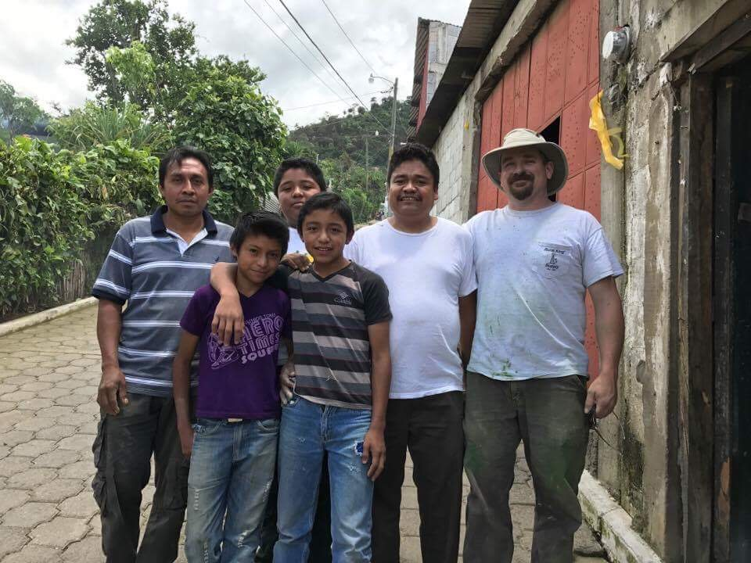

Slide 16
I'm not making it to church. Still pretty weak. Tell my church family that I love them and appreciate the outpouring of love and support they have given me thru this time of sorrow. All my friends just were so impressed with the wonderful service for Tim and the wonderful job that Manuel and Travis and Elihu did with the music. I was worried that Tim wouldn't have many to come but my church family and friends from work came thru. I want all of y'all to know I really appreciate it and love you so much. Keep praying for me.
I want to thank Mark for using his house for all this and Adeline for helping me get through the funeral arrangements. Don’t know how I would have done without them. And I thank God for always being with me.
-Linda

Slide 17
Life

Slide 18
John 11
²⁵ Jesus said to her, “I am the resurrection and the life. The one who believes in me will live, even though they die; ²⁶ and whoever lives by believing in me will never die.”

Slide 19
John 11
³⁵ Jesus wept.
³⁶ Then the people who were standing nearby said, “See how he loved him!”

Slide 20
1 Peter 3
⁸ Finally, all of you should be of one mind. Sympathize with each other. Love each other as brothers and sisters. Be tenderhearted, and keep a humble attitude. ⁹ Don’t repay evil for evil. Don’t retaliate with insults when people insult you. Instead, pay them back with a blessing. That is what God has called you to do, and he will grant you his blessing. ¹⁰ For the Scriptures say,
“If you want to enjoy life and see many happy days, keep your tongue from speaking evil and your lips from telling lies. ¹¹ Turn away from evil and do good. Search for peace, and work to maintain it.

Slide 21
John 11
²⁵ Jesus said to her, “I am the resurrection and the life. The one who believes in me will live, even though they die; ²⁶ and whoever lives by believing in me will never die.”

