Slide 1
Community
Spiritual Formation – part 7

Slide 2
1 John 2
⁷ Dear friends, I am not writing a new commandment for you; rather it is an old one you have had from the very beginning. This old commandment—to love one another—is the same message you heard before. ⁸ Yet it is also new. Jesus lived the truth of this commandment, and you also are living it. For the darkness is disappearing, and the true light is already shining.

Slide 3
1 John 2
⁹ If anyone claims, “I am living in the light,” but hates a fellow believer, that person is still living in darkness. ¹⁰ Anyone who loves a fellow believer is living in the light and does not cause others to stumble. ¹¹ But anyone who hates a fellow believer is still living and walking in darkness. Such a person does not know the way to go, having been blinded by the darkness.

Slide 4
miséō – properly, to detest (on a comparative basis); hence, denounce; to love someone/something less than someone/something else, i.e. to renounce one choice in favor of another; to love less; to esteem less.

Slide 5
1 John 2
⁹ If anyone claims, “I am living in the light,” but hates a fellow believer, that person is still living in darkness. ¹⁰ Anyone who loves a fellow believer is living in the light and does not cause others to stumble. ¹¹ But anyone who hates a fellow believer is still living and walking in darkness. Such a person does not know the way to go, having been blinded by the darkness.

Slide 6
1 John 2
⁵ Do not love this world nor the things it offers you, for when you love the world, you do not have the love of the Father in you. ¹⁶ For the world offers only a craving for physical pleasure, a craving for everything we see, and pride in our achievements and possessions. These are not from the Father, but are from this world. ¹⁷ And this world is fading away, along with everything that people crave. But anyone who does what pleases God will live forever.

Slide 7
“So when we come to deal with spiritual formation of our social dimension, we have to start from woundedness. It is hard to imagine anyone in this world who has not been deeply injured in his or her relationships to others.
The exact nature of the poison of sin in our social dimension is fairly easy to describe, though extremely hard to deal with. It has two forms. They are so closely related that they really are two forms of the same thing: of lovelessness, lack of proper regard and care for others. These two forms are assault or attack and withdrawal or “distancing.” They are so much a part of ordinary human existence that most people think they are just “reality,” and never imagine that we could live without them.“
-Dallas Willard, “Renovation of the Heart”

Slide 8
Assault/Attack – acting against what is good for another; includes any sort of manipulation, belittling, humiliation, using people to our own ends Withdrawal/ distancing - where we regard the well-being and goodness of someone else as matters of indifference, even to the point of despising them.

Slide 9
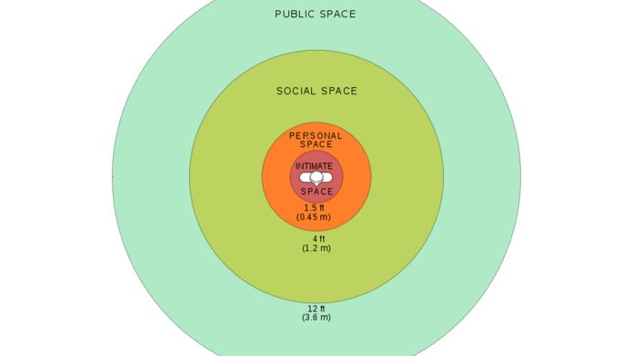

Slide 10
1) See Yourself as God sees you - know 'who and whose you are' 2) Abandon all Defensiveness 3) Lose all Pretense 4) Open up our social relationships to redemption

Slide 11
Romans 12
And so, dear brothers and sisters, I plead with you to give your bodies to God because of all he has done for you. Let them be a living and holy sacrifice—the kind he will find acceptable. This is truly the way to worship him. ² Don’t copy the behavior and customs of this world, but let God transform you into a new person by changing the way you think. Then you will learn to know God’s will for you, which is good and pleasing and perfect.
³ Because of the privilege and authority God has given me, I give each of you this warning: Don’t think you are better than you really are. Be honest in your evaluation of yourselves, measuring yourselves by the faith God has given us. ⁴ Just as our bodies have many parts and each part has a special function, ⁵ so it is with Christ’s body. We are many parts of one body, and we all belong to each other.
⁶ In his grace, God has given us different gifts for doing certain things well. So if God has given you the ability to prophesy, speak out with as much faith as God has given you. ⁷ If your gift is serving others, serve them well. If you are a teacher, teach well. ⁸ If your gift is to encourage others, be encouraging. If it is giving, give generously. If God has given you leadership ability, take the responsibility seriously. And if you have a gift for showing kindness to others, do it gladly.

Slide 12
Romans 12
⁹ Don’t just pretend to love others. Really love them. Hate what is wrong. Hold tightly to what is good. ¹⁰ Love each other with genuine affection, and take delight in honoring each other. ¹¹ Never be lazy, but work hard and serve the Lord enthusiastically. ¹² Rejoice in our confident hope. Be patient in trouble, and keep on praying. ¹³ When God’s people are in need, be ready to help them. Always be eager to practice hospitality.

Slide 13
1 Timothy 3
This is a trustworthy saying: “If someone aspires to be a church leader, he desires an honorable position.” ² So a church leader must be a man whose life is above reproach. He must be faithful to his wife. He must exercise self-control, live wisely, and have a good reputation. He must enjoy having guests in his home, and he must be able to teach. ³ He must not be a heavy drinker or be violent. He must be gentle, not quarrelsome, and not love money. ⁴ He must manage his own family well, having children who respect and obey him. ⁵ For if a man cannot manage his own household, how can he take care of God’s church?

Slide 14
Romans 12
⁹ Don’t just pretend to love others. Really love them. Hate what is wrong. Hold tightly to what is good. ¹⁰ Love each other with genuine affection, and take delight in honoring each other. ¹¹ Never be lazy, but work hard and serve the Lord enthusiastically. ¹² Rejoice in our confident hope. Be patient in trouble, and keep on praying. ¹³ When God’s people are in need, be ready to help them. Always be eager to practice hospitality.

Slide 15
Philippians 4
Final Exhortations
⁴ Rejoice in the Lord always. I will say it again: Rejoice!

