Slide 1
The Mountain
Advent 2019 – part 1

Slide 3
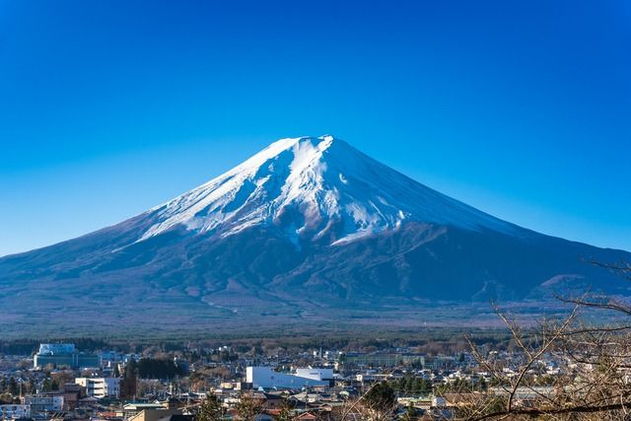

Slide 4
Isaiah 2
This is a vision that Isaiah son of Amoz saw concerning Judah and Jerusalem:

Slide 5
Isaiah 2
² In the last days, the mountain of the Lord’s house will be the highest of all— the most important place on earth. It will be raised above the other hills, and people from all over the world will stream there to worship. ³ People from many nations will come and say, “Come, let us go up to the mountain of the Lord, to the house of Jacob’s God. There he will teach us his ways, and we will walk in his paths.”

Slide 6
Isaiah 1
²¹ See how the faithful city has become a prostitute! She once was full of justice; righteousness used to dwell in her— but now murderers! ²² Your silver has become dross, your choice wine is diluted with water. ²³ Your rulers are rebels, partners with thieves; they all love bribes and chase after gifts. They do not defend the cause of the fatherless; the widow’s case does not come before them.

Slide 7
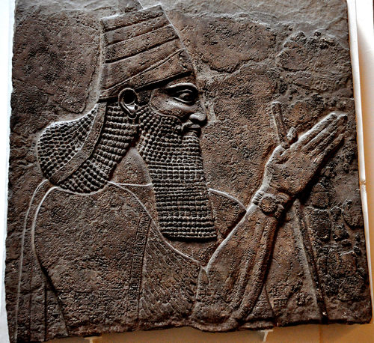

Slide 8
2 Kings 15
²⁷ Pekah son of Remaliah began to rule over Israel in the fifty-second year of King Uzziah’s reign in Judah. He reigned in Samaria twenty years. ²⁸ But Pekah did what was evil in the Lord’s sight. He refused to turn from the sins that Jeroboam son of Nebat had led Israel to commit.
²⁹ During Pekah’s reign, King Tiglath-pileser of Assyria attacked Israel again, and he captured the towns of Ijon, Abel-beth-maacah, Janoah, Kedesh, and Hazor. He also conquered the regions of Gilead, Galilee, and all of Naphtali, and he took the people to Assyria as captives. ³⁰ Then Hoshea son of Elah conspired against Pekah and assassinated him. He began to rule over Israel in the twentieth year of Jotham son of Uzziah.

Slide 9
Isaiah 2
For the Lord’s teaching will go out from Zion; his word will go out from Jerusalem. ⁴ The Lord will mediate between peoples and will settle disputes. They will hammer their swords into plowshares and their spears into pruning hooks. Nation will no longer fight against nation, nor train for war anymore.

Slide 10
Isaiah 2
For the Lord’s teaching will go out from Zion; his word will go out from Jerusalem. ⁴ The Lord will mediate between peoples and will settle disputes. They will hammer their swords into plowshares and their spears into pruning hooks. Nation will no longer fight against nation, nor train for war anymore.

Slide 11
Isaiah 11
A shoot will come up from the stump of Jesse; from his roots a Branch will bear fruit. ² The Spirit of the Lord will rest on him— the Spirit of wisdom and of understanding, the Spirit of counsel and of might, the Spirit of the knowledge and fear of the Lord— ³ and he will delight in the fear of the Lord.
He will not judge by what he sees with his eyes, or decide by what he hears with his ears; ⁴ but with righteousness he will judge the needy, with justice he will give decisions for the poor of the earth. He will strike the earth with the rod of his mouth; with the breath of his lips he will slay the wicked. ⁵ Righteousness will be his belt and faithfulness the sash around his waist.

Slide 12
Isaiah 11
⁶ The wolf will live with the lamb, the leopard will lie down with the goat, the calf and the lion and the yearling^{[a]} together; and a little child will lead them. ⁷ The cow will feed with the bear, their young will lie down together, and the lion will eat straw like the ox. ⁸ The infant will play near the cobra’s den, and the young child will put its hand into the viper’s nest. ⁹ They will neither harm nor destroy on all my holy mountain, for the earth will be filled with the knowledge of the Lord as the waters cover the sea.

Slide 15
Romans 13
⁸ Let no debt remain outstanding, except the continuing debt to love one another, for whoever loves others has fulfilled the law. ⁹ The commandments, “You shall not commit adultery,” “You shall not murder,” “You shall not steal,” “You shall not covet,” and whatever other command there may be, are summed up in this one command: “Love your neighbor as yourself.”¹⁰ Love does no harm to a neighbor. Therefore love is the fulfillment of the law.
¹¹ And do this, understanding the present time: The hour has already come for you to wake up from your slumber, because our salvation is nearer now than when we first believed. ¹² The night is nearly over; the day is almost here. So let us put aside the deeds of darkness and put on the armor of light. ¹³ Let us behave decently, as in the daytime, not in carousing and drunkenness, not in sexual immorality and debauchery, not in dissension and jealousy. ¹⁴ Rather, clothe yourselves with the presence of Christ, and do not think about how to gratify the desires of the flesh.

Slide 16
Psalm 121
A song of ascents.
¹ I lift up my eyes to the mountains— where does my help come from? ² My help comes from the Lord, the Maker of heaven and earth.
³ He will not let your foot slip— he who watches over you will not slumber; ⁴ indeed, he who watches over Israel will neither slumber nor sleep.
⁵ The Lord watches over you— the Lord is your shade at your right hand; ⁶ the sun will not harm you by day, nor the moon by night.
⁷ The Lord will keep you from all harm— he will watch over your life; ⁸ the Lord will watch over your coming and going both now and forevermore.

