Slide 1
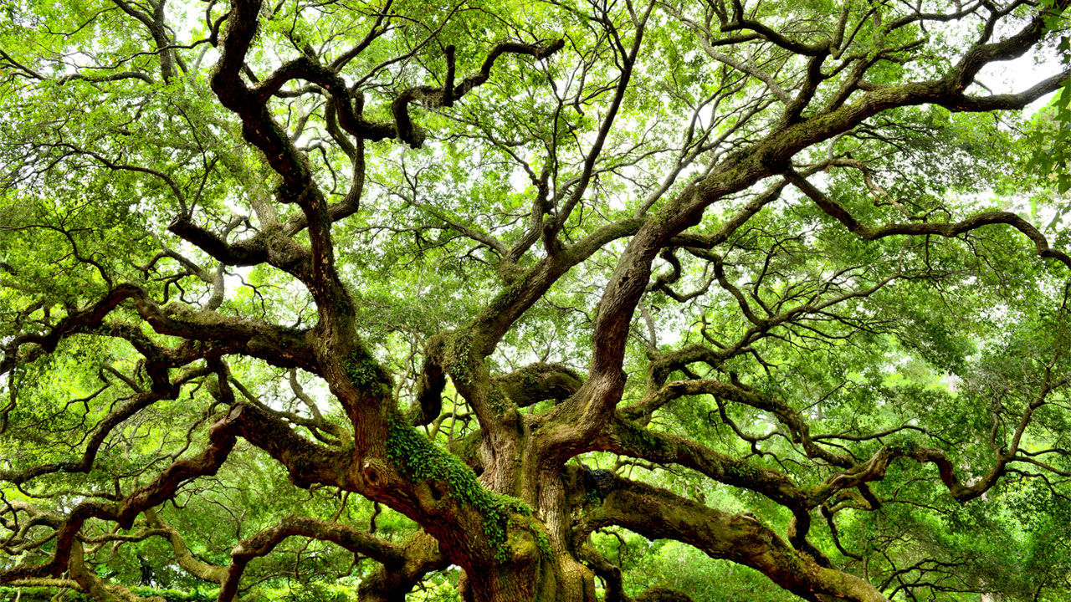
Between the Trees

Slide 2
Genesis 1
²⁶ Then God said, “Let us make human beings in our image, to be like us. They will reign over the fish in the sea, the birds in the sky, the livestock, all the wild animals on the earth, and the small animals that scurry along the ground.”
²⁷ So God created human beings in his own image. In the image of God he created them; male and female he created them.
²⁸ Then God blessed them and said, “Be fruitful and multiply. Fill the earth and govern it. Reign over the fish in the sea, the birds in the sky, and all the animals that scurry along the ground.”…
³¹ Then God looked over all he had made, and he saw that it was very good!

Slide 3
Genesis 2
⁸ Then the Lord God planted a garden in Eden in the east, and there he placed the man he had made. ⁹ The Lord God made all sorts of trees grow up from the ground—trees that were beautiful and that produced delicious fruit. In the middle of the garden he placed the tree of life and the tree of the knowledge of good and evil.
¹⁵ The Lord God placed the man in the Garden of Eden to tend and watch over it. ¹⁶ But the Lord God warned him, “You may freely eat the fruit of every tree in the garden— ¹⁷ except the tree of the knowledge of good and evil. If you eat its fruit, you are sure to die.”

Slide 4
Genesis 3
Now the serpent was more crafty than any other beast of the field that the Lord God had made.
He said to the woman, “Did God actually say, ‘You shall not eat of any tree in the garden’?” ² And the woman said to the serpent, “We may eat of the fruit of the trees in the garden, ³ but God said, ‘You shall not eat of the fruit of the tree that is in the midst of the garden, neither shall you touch it, lest you die.’” ⁴ But the serpent said to the woman, “You will not surely die. ⁵ For God knows that when you eat of it your eyes will be opened, and you will be like God, knowing good and evil.” ⁶ So when the woman saw that the tree was good for food, and that it was a delight to the eyes, and that the tree was to be desired to make one wise, she took of its fruit and ate, and she also gave some to her husband who was with her, and he ate. ⁷ Then the eyes of both were opened, and they knew that they were naked. And they sewed fig leaves together and made themselves loincloths.

Slide 5
Genesis 3
⁸ And they heard the sound of the Lord God walking in the garden in the cool of the day, and the man and his wife hid themselves from the presence of the Lord God among the trees of the garden. ⁹ But the Lord God called to the man and said to him, “Where are you?” ¹⁰ And he said, “I heard the sound of you in the garden, and I was afraid, because I was naked, and I hid myself.” ¹¹ He said, “Who told you that you were naked? Have you eaten of the tree of which I commanded you not to eat?” ¹² The man said, “The woman whom you gave to be with me, she gave me fruit of the tree, and I ate.” ¹³ Then the Lord God said to the woman, “What is this that you have done?” The woman said, “The serpent deceived me, and I ate.”

Slide 6
Genesis 3
²² Then the Lord God said, “Behold, the man has become like one of us in knowing good and evil. Now, lest he reach out his hand and take also of the tree of life and eat, and live forever—” ²³ therefore the Lord God sent him out from the garden of Eden to work the ground from which he was taken. ²⁴ He drove out the man, and at the east of the garden of Eden he placed the cherubim and a flaming sword that turned every way to guard the way to the tree of life.

Slide 7
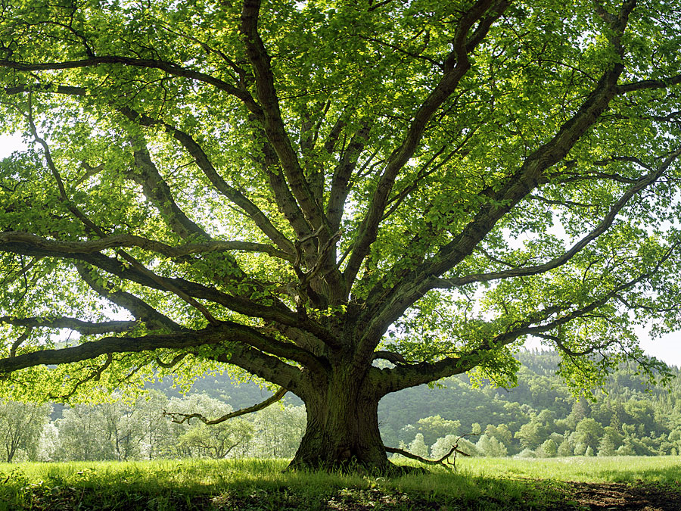

Slide 8
Revelation 1
¹² When I turned to see who was speaking to me, I saw seven gold lampstands. ¹³ And standing in the middle of the lampstands was someone like the Son of Man. He was wearing a long robe with a gold sash across his chest. ¹⁴ His head and his hair were white like wool, as white as snow. And his eyes were like flames of fire. ¹⁵ His feet were like polished bronze refined in a furnace, and his voice thundered like mighty ocean waves. ¹⁶ He held seven stars in his right hand, and a sharp two-edged sword came from his mouth. And his face was like the sun in all its brilliance.
¹⁷ When I saw him, I fell at his feet as if I were dead. But he laid his right hand on me and said, “Don’t be afraid! I am the First and the Last. ¹⁸ I am the living one. I died, but look—I am alive forever and ever! And I hold the keys of death and the grave.

Slide 9
Revelation 21
Then I saw a new heaven and a new earth, for the old heaven and the old earth had disappeared. And the sea was also gone. ² And I saw the holy city, the new Jerusalem, coming down from God out of heaven like a bride beautifully dressed for her husband.
³ I heard a loud shout from the throne, saying, “Look, God’s home is now among his people! He will live with them, and they will be his people. God himself will be with them. ⁴ He will wipe every tear from their eyes, and there will be no more death or sorrow or crying or pain. All these things are gone forever.”

Slide 10
Revelation 21
⁵ And the one sitting on the throne said, “Look, I am making everything new!” And then he said to me, “Write this down, for what I tell you is trustworthy and true.” ⁶ And he also said, “It is finished! I am the Alpha and the Omega—the Beginning and the End. To all who are thirsty I will give freely from the springs of the water of life. ⁷ All who are victorious will inherit all these blessings, and I will be their God, and they will be my children.
⁸ “But cowards, unbelievers, the corrupt, murderers, the immoral, those who practice witchcraft, idol worshipers, and all liars—their fate is in the fiery lake of burning sulfur. This is the second death.”
⁹ Then one of the seven angels who held the seven bowls containing the seven last plagues came and said to me, “Come with me! I will show you the bride, the wife of the Lamb.”

Slide 11
Revelation 21
²² I saw no temple in the city, for the Lord God Almighty and the Lamb are its temple. ²³ And the city has no need of sun or moon, for the glory of God illuminates the city, and the Lamb is its light. ²⁴ The nations will walk in its light, and the kings of the world will enter the city in all their glory. ²⁵ Its gates will never be closed at the end of day because there is no night there. ²⁶ And all the nations will bring their glory and honor into the city.

Slide 12
Revelation 22
Then the angel showed me the river of the water of life, as clear as crystal, flowing from the throne of God and of the Lamb ² down the middle of the great street of the city. On each side of the river stood the tree of life, bearing twelve crops of fruit, yielding its fruit every month. And the leaves of the tree are for the healing of the nations. ³ No longer will there be any curse. The throne of God and of the Lamb will be in the city, and his servants will serve him.

Slide 14
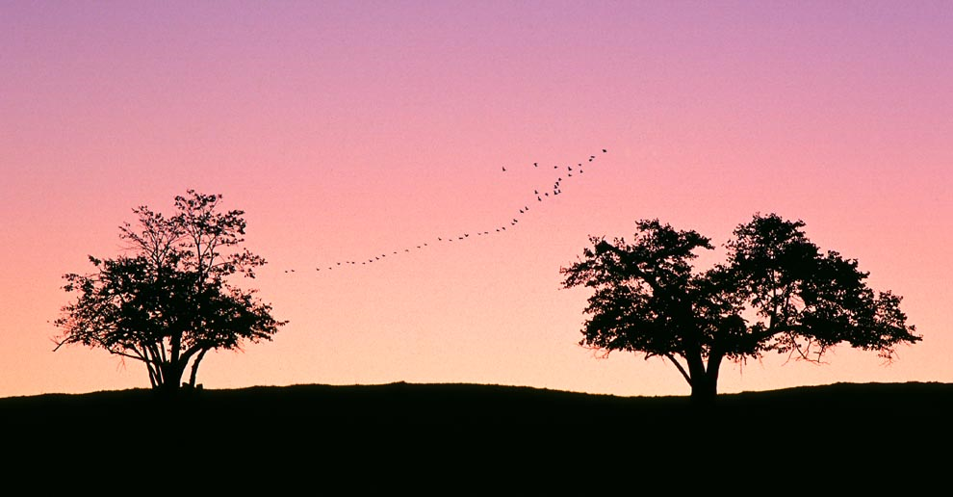

Slide 15
1 Corinthians 15
²⁰ But Christ has indeed been raised from the dead, the firstfruits of those who have fallen asleep. ²¹ For since death came through a man, the resurrection of the dead comes also through a man. ²² For as in Adam all die, so in Christ all will be made alive.

Slide 16
1 Corinthians 15
⁵⁴ When the perishable has been clothed with the imperishable, and the mortal with immortality, then the saying that is written will come true: “Death has been swallowed up in victory.”
⁵⁵ “Where, O death, is your victory? Where, O death, is your sting?”
⁵⁶ The sting of death is sin, and the power of sin is the law. ⁵⁷ But thanks be to God! He gives us the victory through our Lord Jesus Christ.
⁵⁸ Therefore, my dear brothers and sisters, stand firm. Let nothing move you. Always give yourselves fully to the work of the Lord, because you know that your labor in the Lord is not in vain.

Slide 17
Luke 13
¹⁸ Then Jesus said, “What is the Kingdom of God like? How can I illustrate it? ¹⁹ It is like a tiny mustard seed that a man planted in a garden; it grows and becomes a tree, and the birds make nests in its branches.”

