Slide 1
Psychology in Christianity

Slide 2
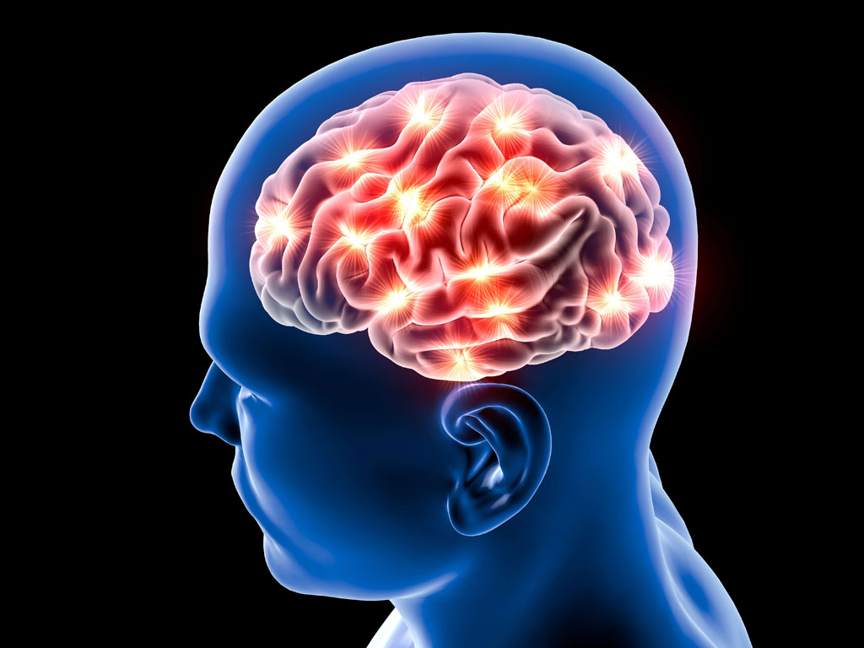
The Learning Process

Slide 3
How the brain learns through senses then reinforcements
Past experiences being witnessed to effect greatly how a person will react
Immediate Gratification vs. Delayed
Empathy Based Motivation
5 stages of change

Slide 4
The Five Stages of Change
Precontemplation
Contemplation
Preparation
Action
Maintenance

Slide 5
³ Don’t be selfish; don’t try to impress others. Be humble, thinking of others as better than yourselves. ⁴ Don’t look out only for your own interests, but take an interest in others, too.
⁵ You must have the same attitude that Christ Jesus had.
⁶ Though he was God, he did not think of equality with God as something to cling to.⁷ Instead, he gave up his divine privileges; he took the humble position of a slave and was born as a human being. When he appeared in human form,⁸ he humbled himself in obedience to God and died a criminal’s death on a cross. ⁹ Therefore, God elevated him to the place of highest honor and gave him the name above all other names, ¹⁰ that at the name of Jesus every knee should bow, in heaven and on earth and under the earth, ¹¹ and every tongue declare that Jesus Christ is Lord, to the glory of God the Father.
Philippians 2

Slide 6
Humility
Being able to communicate regardless of social status
Talking up someone instead of talking down
Finding interests in others regardless of what their interests may be.

Slide 7
Building the relationship
Building rapport
Understanding non-verbal communication
Understanding when is the right moment to discuss change
Situations that provide the most opportunity to discuss change

Slide 8
The witnessing conversation
Allowing others to self-realize
Being a guide
Understanding the severity and length of the conversation

Slide 9
²⁴ Then Jesus said to his disciples, “If any of you wants to be my follower, you must give up your own way, take up your cross, and follow me. ²⁵ If you try to hang on to your life, you will lose it. But if you give up your life for my sake, you will save it.”
Matthew 16

Slide 10
Sustaining change
Support
Understanding gratification in change

