Slide 1
Feeling
Spiritual Formation – part 3

Slide 2
If it feels good, __ __

Slide 3
Be true to ____ ____

Slide 4
The heart wants what it _____

Slide 5
This is a modern fairy tale No happy endings No wind in our sails
Save your advice 'cause I won't hear You might be right but I don't care There's a million reasons why I should give you up But the heart wants what it wants

Slide 6
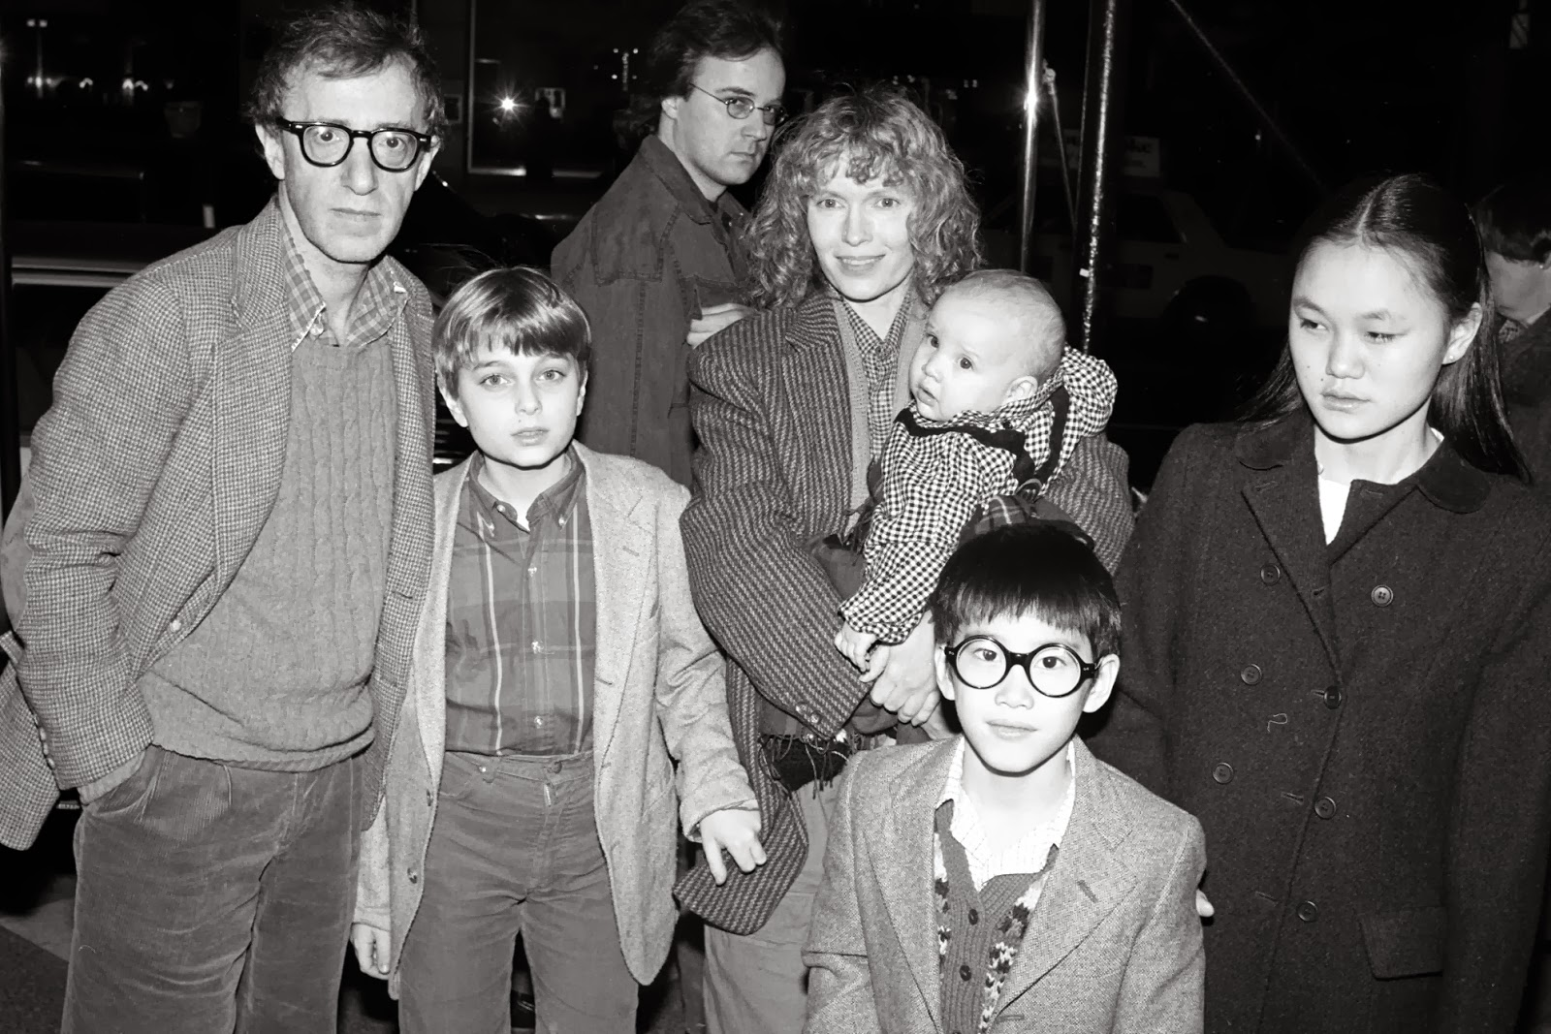

Slide 7
The heart wants what it wants

Slide 8
Matthew 5
³⁹ But I say, do not resist an evil person! If someone slaps you on the right cheek, offer the other cheek also. ⁴⁰ If you are sued in court and your shirt is taken from you, give your coat, too. ⁴¹ If a soldier demands that you carry his gear for a mile, carry it two miles. ⁴² Give to those who ask, and don’t turn away from those who want to borrow.
⁴³ “You have heard the law that says, ‘Love your neighbor’ and hate your enemy. ⁴⁴ But I say, love your enemies! Pray for those who persecute you! ⁴⁵ In that way, you will be acting as true children of your Father in heaven. For he gives his sunlight to both the evil and the good, and he sends rain on the just and the unjust alike. ⁴⁶ If you love only those who love you, what reward is there for that? Even corrupt tax collectors do that much. ⁴⁷ If you are kind only to your friends, how are you different from anyone else? Even pagans do that. ⁴⁸ But you are to be perfect, even as your Father in heaven is perfect.

Slide 9
Matthew 6
²⁵ “Therefore I tell you, do not worry about your life, what you will eat or drink; or about your body, what you will wear. Is not life more than food, and the body more than clothes? ²⁶ Look at the birds of the air; they do not sow or reap or store away in barns, and yet your heavenly Father feeds them. Are you not much more valuable than they? ²⁷ Can any one of you by worrying add a single hour to your life?

Slide 10
Matthew 6
²⁸ “And why do you worry about clothes? See how the flowers of the field grow. They do not labor or spin. ²⁹ Yet I tell you that not even Solomon in all his splendor was dressed like one of these. ³⁰ If that is how God clothes the grass of the field, which is here today and tomorrow is thrown into the fire, will he not much more clothe you—you of little faith? ³¹ So do not worry, saying, ‘What shall we eat?’ or ‘What shall we drink?’ or ‘What shall we wear?’ ³² For the pagans run after all these things, and your heavenly Father knows that you need them. ³³ But seek first his kingdom and his righteousness, and all these things will be given to you as well. ³⁴ Therefore do not worry about tomorrow, for tomorrow will worry about itself. Each day has enough trouble of its own.

Slide 11
Philippians 1
³ I thank my God every time I remember you. ⁴ In all my prayers for all of you, I always pray with joy ⁵ because of your partnership in the gospel from the first day until now, ⁶ being confident of this, that he who began a good work in you will carry it on to completion until the day of Christ Jesus.
⁷ It is right for me to feel this way about all of you, since I have you in my heart and, whether I am in chains or defending and confirming the gospel, all of you share in God’s grace with me. ⁸ God can testify how I long for all of you with the affection of Christ Jesus.
⁹ And this is my prayer: that your love may abound more and more in knowledge and depth of insight, ¹⁰ so that you may be able to discern what is best and may be pure and blameless for the day of Christ, ¹¹ filled with the fruit of righteousness that comes through Jesus Christ—to the glory and praise of God.

Slide 12
Philippians 2
Is there any encouragement from belonging to Christ? Any comfort from his love? Any fellowship together in the Spirit? Are your hearts tender and compassionate? ² Then make me truly happy by agreeing wholeheartedly with each other, loving one another, and working together with one mind and purpose.
³ Don’t be selfish; don’t try to impress others. Be humble, thinking of others as better than yourselves. ⁴ Don’t look out only for your own interests, but take an interest in others, too.

Slide 13
Philippians 4
⁴ Always be full of joy in the Lord. I say it again—rejoice! ⁵ Let everyone see that you are considerate in all you do. Remember, the Lord is coming soon.
⁶ Don’t worry about anything; instead, pray about everything. Tell God what you need, and thank him for all he has done. ⁷ Then you will experience God’s peace, which exceeds anything we can understand. His peace will guard your hearts and minds as you live in Christ Jesus.
⁸ And now, dear brothers and sisters, one final thing. Fix your thoughts on what is true, and honorable, and right, and pure, and lovely, and admirable. Think about things that are excellent and worthy of praise. ⁹ Keep putting into practice all you learned and received from me—everything you heard from me and saw me doing. Then the God of peace will be with you.

Slide 14
Love: to will the good of another
Joy: pervasive sense of overall and ultimate well-being
Peace: rest of will that results from assurance about how things will turn out

Slide 15
Philippians 3
² I don’t mean to say that I have already achieved these things or that I have already reached perfection. But I press on to possess that perfection for which Christ Jesus first possessed me. ¹³ No, dear brothers and sisters, I have not achieved it, but I focus on this one thing: Forgetting the past and looking forward to what lies ahead, ¹⁴ I press on to reach the end of the race and receive the heavenly prize for which God, through Christ Jesus, is calling us.

