Slide 1
Love What is Good
Titus – part 1

Slide 2
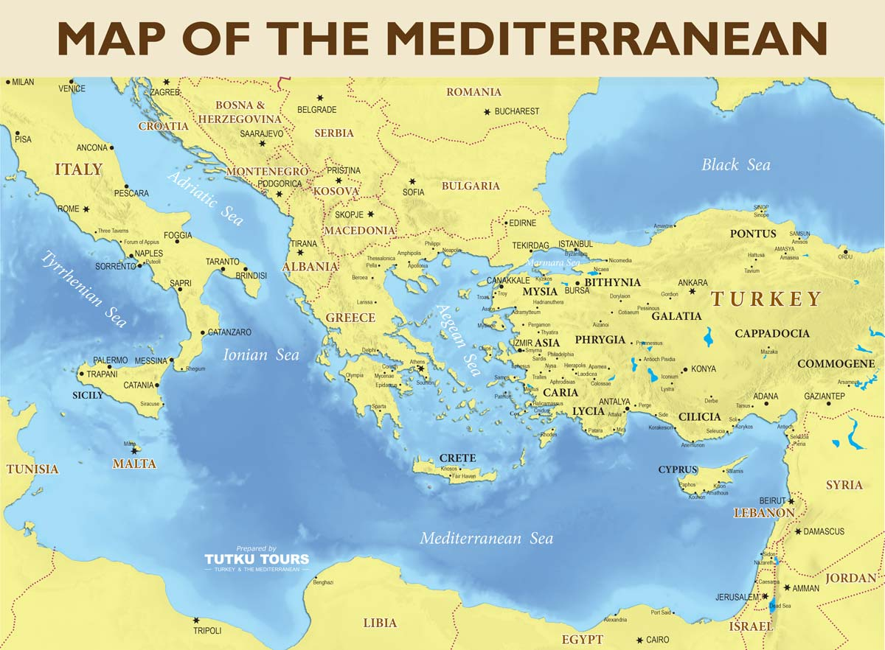

Slide 3
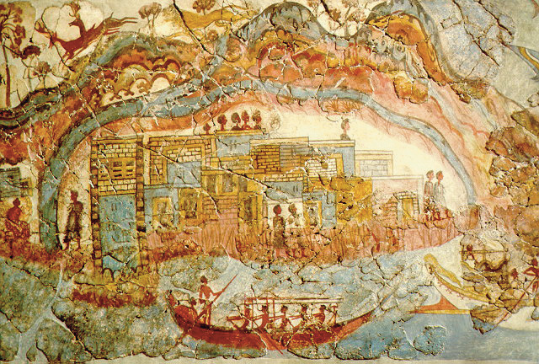

Slide 4
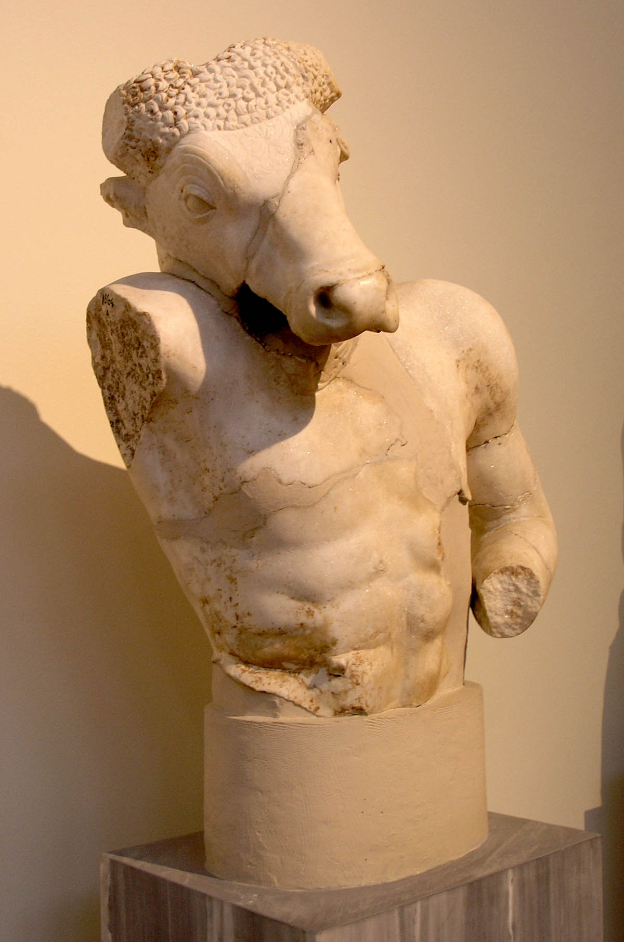

Slide 5
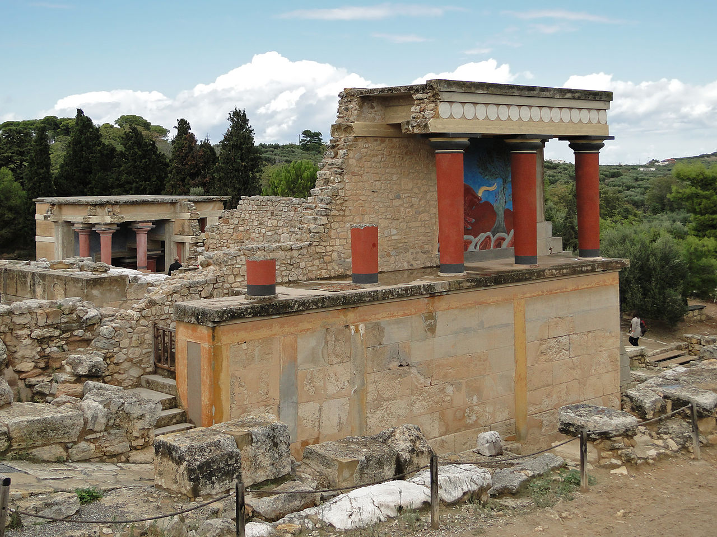

Slide 6
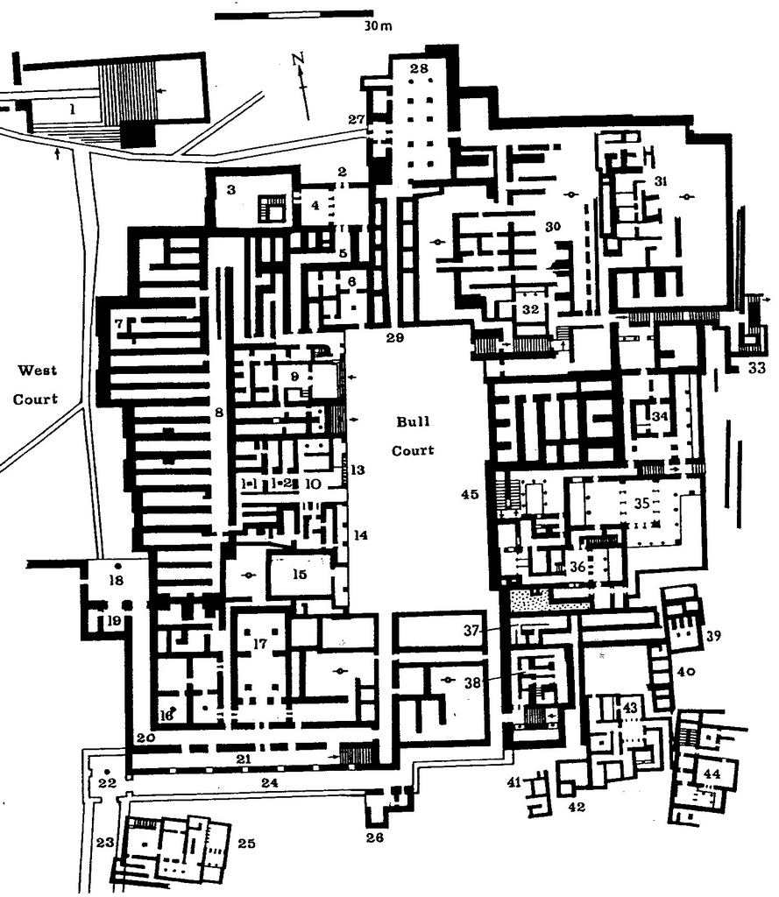

Slide 7
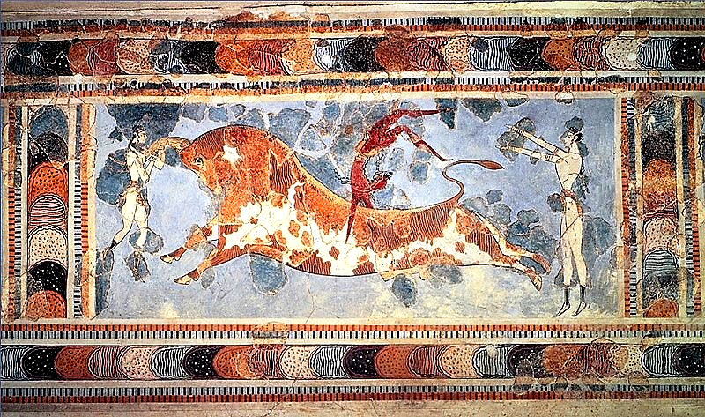

Slide 8
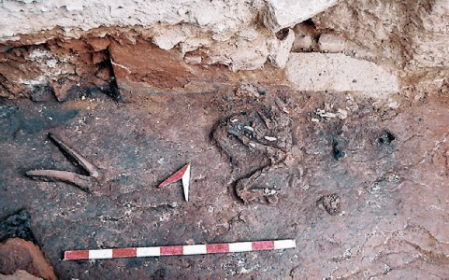

Slide 9
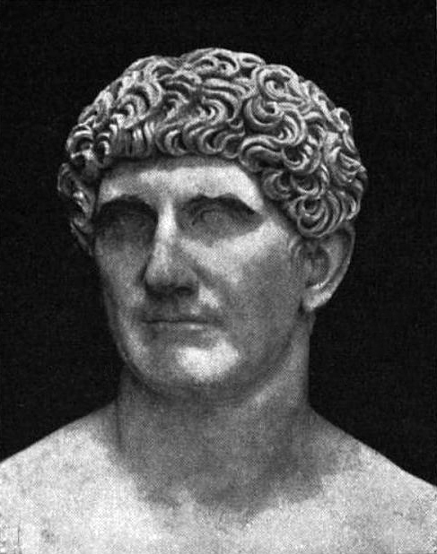

Slide 10
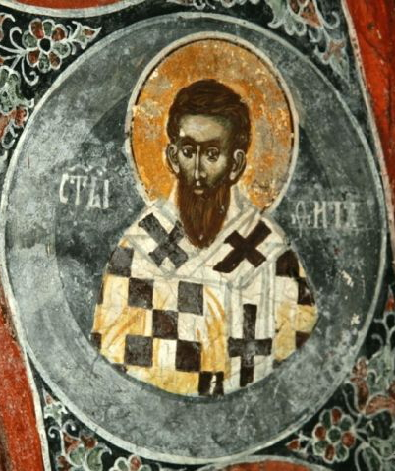

Slide 11
Titus 1
Paul, a servant of God and an apostle of Jesus Christ to further the faith of God’s elect and their knowledge of the truth that leads to godliness— ² in the hope of eternal life, which God, who does not lie, promised before the beginning of time, ³ and which now at his appointed season he has brought to light through the preaching entrusted to me by the command of God our Savior,
⁴ To Titus, my true son in our common faith:
Grace and peace from God the Father and Christ Jesus our Savior.

Slide 12
Titus 1
Paul, a servant of God and an apostle of Jesus Christ to further the faith of God’s elect and their knowledge of the truth that leads to godliness— ² in the hope of eternal life, which God, who does not lie, promised before the beginning of time, ³ and which now at his appointed season he has brought to light through the preaching entrusted to me by the command of God our Savior,
⁴ To Titus, my true son in our common faith:
Grace and peace from God the Father and Christ Jesus our Savior.

Slide 13
Titus 1
Paul, a servant of God and an apostle of Jesus Christ to further the faith of God’s elect and their knowledge of the truth that leads to godliness— ² in the hope of eternal life, which God, who does not lie, promised before the beginning of time, ³ and which now at his appointed season he has brought to light through the preaching entrusted to me by the command of God our Savior,
⁴ To Titus, my true son in our common faith:
Grace and peace from God the Father and Christ Jesus our Savior.

Slide 14
Titus 1
⁵ The reason I left you in Crete was that you might put in order what was left unfinished and appoint elders in every town, as I directed you. ⁶ An elder must be blameless, faithful to his wife, a man whose children believe and are not open to the charge of being wild and disobedient. ⁷ Since an overseer manages God’s household, he must be blameless—not overbearing, not quick-tempered, not given to drunkenness, not violent, not pursuing dishonest gain.

Slide 15
Titus 1
⁸ Rather, he must be hospitable, one who loves what is good, who is self-controlled, upright, holy and disciplined. ⁹ He must hold firmly to the trustworthy message as it has been taught, so that he can encourage others by sound doctrine and refute those who oppose it.

Slide 16
Titus 1
¹⁰ For there are many rebellious people, full of meaningless talk and deception, especially those of the circumcision group. ¹¹ They must be silenced, because they are disrupting whole households by teaching things they ought not to teach—and that for the sake of dishonest gain.
¹² One of Crete’s own prophets has said it: “Cretans are always liars, evil brutes, lazy gluttons.” ¹³ This saying is true. Therefore rebuke them sharply, so that they will be sound in the faith ¹⁴ and will pay no attention to Jewish myths or to the merely human commands of those who reject the truth.

Slide 17
Titus 1
¹⁵ To the pure, all things are pure, but to those who are corrupted and do not believe, nothing is pure. In fact, both their minds and consciences are corrupted. ¹⁶ They claim to know God, but by their actions they deny him. They are detestable, disobedient and unfit for doing anything good.

Slide 18
Titus 1
⁸ Rather, he must be hospitable, one who loves what is good, who is self-controlled, upright, holy and disciplined. ⁹ He must hold firmly to the trustworthy message as it has been taught, so that he can encourage others by sound doctrine and refute those who oppose it.

Slide 19
Titus 1
Paul, a servant of God and an apostle of Jesus Christ to further the faith of God’s elect and their knowledge of the truth that leads to godliness— ² in the hope of eternal life, which God, who does not lie, promised before the beginning of time, ³ and which now at his appointed season he has brought to light through the preaching entrusted to me by the command of God our Savior,
⁴ To Titus, my true son in our common faith:
Grace and peace from God the Father and Christ Jesus our Savior.

