Slide 1
Being Hated and Hating
Titus – part 3

Slide 2
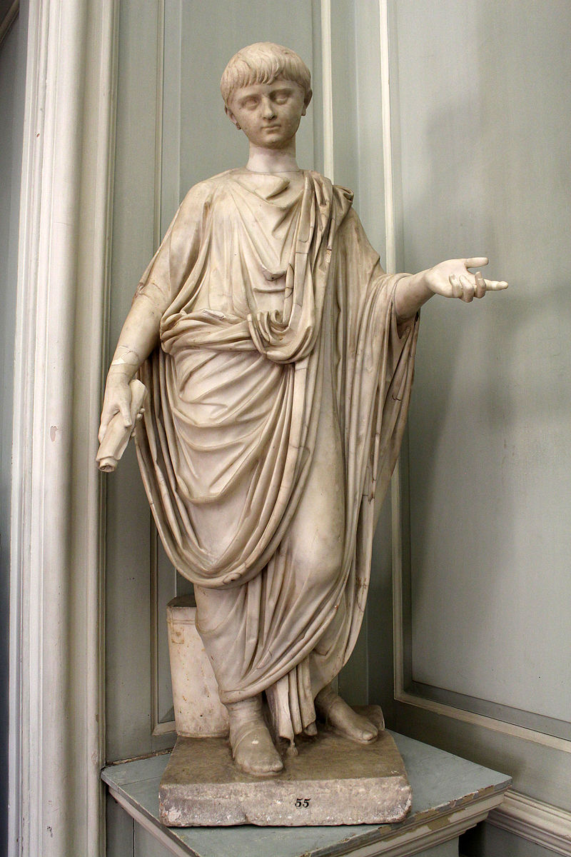

Slide 3
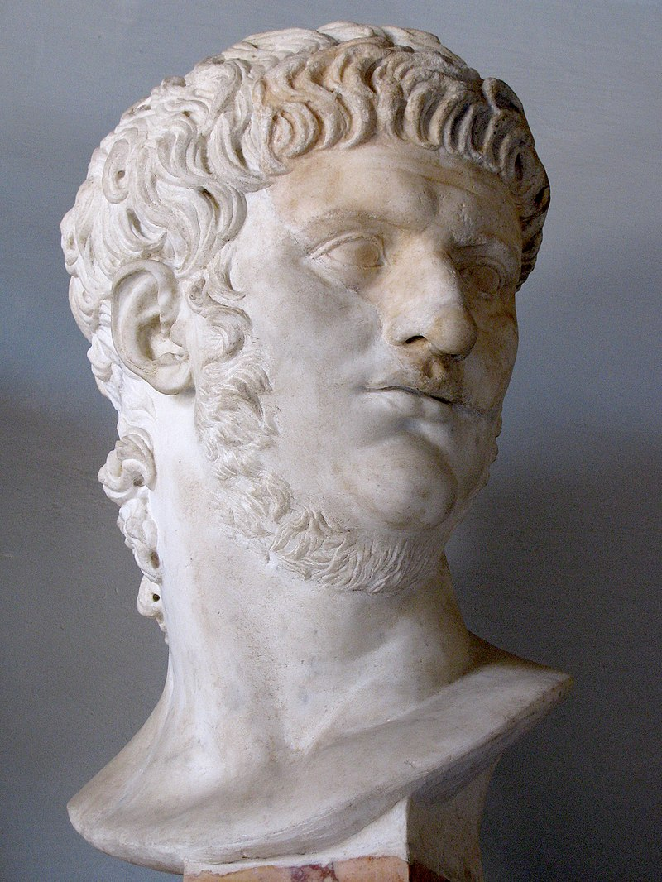

Slide 4
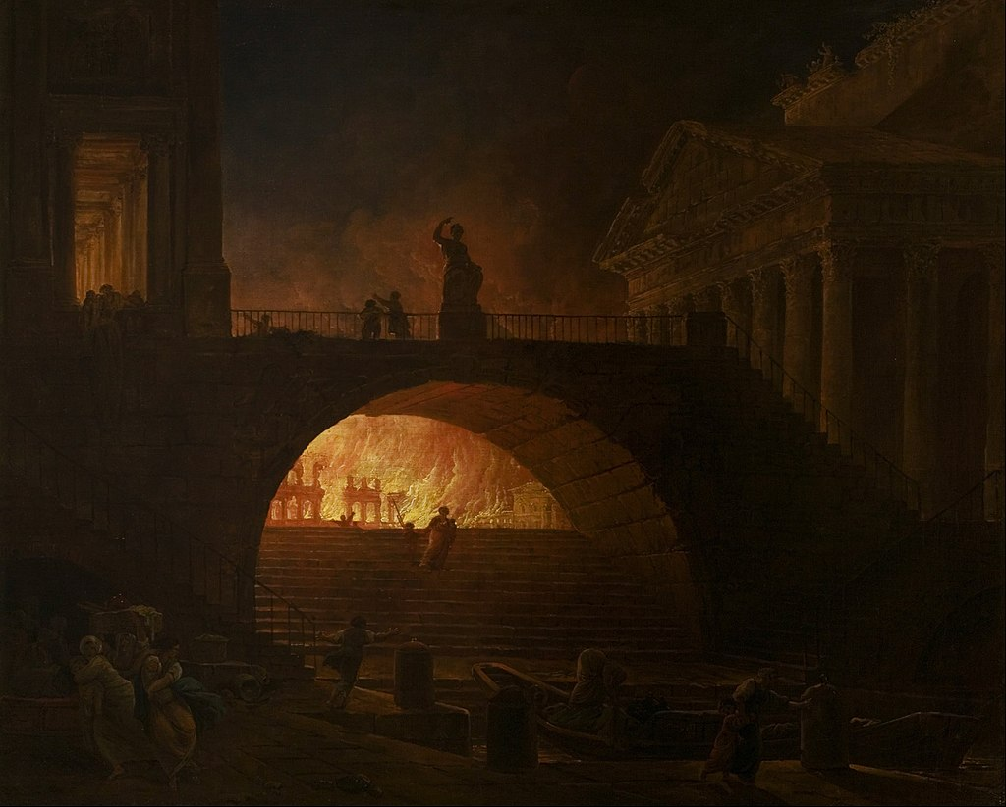

Slide 5
Titus 3
Remind the people to be subject to rulers and authorities, to be obedient, to be ready to do whatever is good, ² to slander no one, to be peaceable and considerate, and always to be gentle toward everyone.

Slide 6
Titus 3
³ At one time we too were foolish, disobedient, deceived and enslaved by all kinds of passions and pleasures. We lived in malice and envy, being hated and hating one another.

Slide 7
Titus 3
⁴ But when the kindness and love of God our Savior appeared, ⁵ he saved us, not because of righteous things we had done, but because of his mercy. He saved us through the washing of rebirth and renewal by the Holy Spirit, ⁶ whom he poured out on us generously through Jesus Christ our Savior, ⁷ so that, having been justified by his grace, we might become heirs having the hope of eternal life.

Slide 8
Titus 3
⁸ This is a trustworthy saying. And I want you to stress these things, so that those who have trusted in God may be careful to devote themselves to doing what is good. These things are excellent and profitable for everyone.

Slide 9
Titus 3
⁸ This is a trustworthy saying. And I want you to stress these things, so that those who have trusted in God may be careful to devote themselves to doing what is good. These things are excellent and profitable for everyone.

Slide 10
Titus 3
Remind the people to be subject to rulers and authorities, to be obedient, to be ready to do whatever is good, ² to slander no one, to be peaceable and considerate, and always to be gentle toward everyone.

Slide 11
Titus 3
⁹ But avoid foolish controversies and genealogies and arguments and quarrels about the law, because these are unprofitable and useless.

Slide 12
Titus 3
⁹ But avoid foolish controversies and genealogies and arguments and quarrels about the law, because these are unprofitable and useless.

Slide 13
Predestination/Free will
Pre-/Post-/A-millennialism
Bible translations

Slide 14
Conservative/Liberal
Healthcare
Gun control
Climate change

Slide 15
Titus 3
¹⁰ A man that is an heretic after the first and second admonition reject;

Slide 16
hairetikós

Slide 17
hairetikós
Causing division; disposed to form sects, sectarian, factious
(an adjective, derived from hairéomai, "to choose, have a distinctive opinion") – a factious person, specializing in half-truths and misimpressions "to win others over" to their personal opinion (misguided zeal) – while creating harmful divisions

Slide 18
Titus 3
¹⁰ Warn a divisive person once, and then warn them a second time. After that, have nothing to do with them. ¹¹ You may be sure that such people are warped and sinful; they are self-condemned.

Slide 19
Titus 3
² As soon as I send Artemas or Tychicus to you, do your best to come to me at Nicopolis, because I have decided to winter there. ¹³ Do everything you can to help Zenas the lawyer and Apollos on their way and see that they have everything they need. ¹⁴ Our people must learn to devote themselves to doing what is good, in order to provide for urgent needs and not live unproductive lives.
¹⁵ Everyone with me sends you greetings. Greet those who love us in the faith.
Grace be with you all.

Slide 20
Titus 3
Remind the people to be subject to rulers and authorities, to be obedient, to be ready to do whatever is good, ² to slander no one, to be peaceable and considerate, and always to be gentle toward everyone.
³ At one time we too were foolish, disobedient, deceived and enslaved by all kinds of passions and pleasures. We lived in malice and envy, being hated and hating one another. ⁴ But when the kindness and love of God our Savior appeared, ⁵ he saved us, not because of righteous things we had done, but because of his mercy. He saved us through the washing of rebirth and renewal by the Holy Spirit, ⁶ whom he poured out on us generously through Jesus Christ our Savior, ⁷ so that, having been justified by his grace, we might become heirs having the hope of eternal life. ⁸ This is a trustworthy saying. And I want you to stress these things, so that those who have trusted in God may be careful to devote themselves to doing what is good. These things are excellent and profitable for everyone.

